Slide 1
19
Earnings and Discrimination

Slide 2

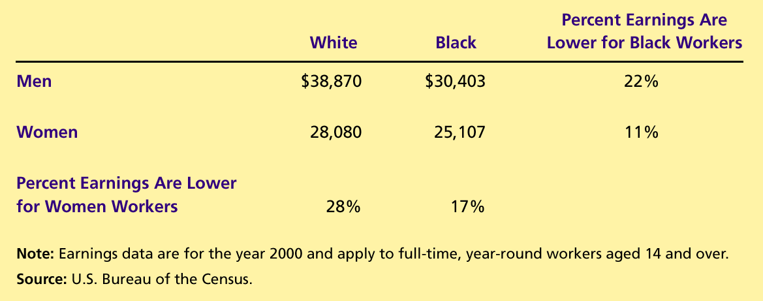
Table 1 Median Annual Earnings by Race and Sex
Copyright©2004 South-Western

